Slide 1
Alibaba B2B Platform
Data Analysis & Business Strategy
Alicia, Bixia, Chichi, Deeksha, Swetosree, Varsha, Namita, Catherine, Ruiying

Slide 2
Agenda
Introduction of Dataset
Exploratory Data Analysis
Direct, Search and Referral Volume
Search & Display AD
Seller Community
Membership
Data-Driven Business Strategy

Slide 3
Introduction of Dataset
Calculate Revenue Channels
Commission Revenue = (DV+SV+RV)*average value of transaction*commission rate
AD Revenue = Search AD + Display AD
Membership Revenue = Membership*3000
Total Revenue = Sales Reveune + AD Revenue + Membership Revenue

Slide 4
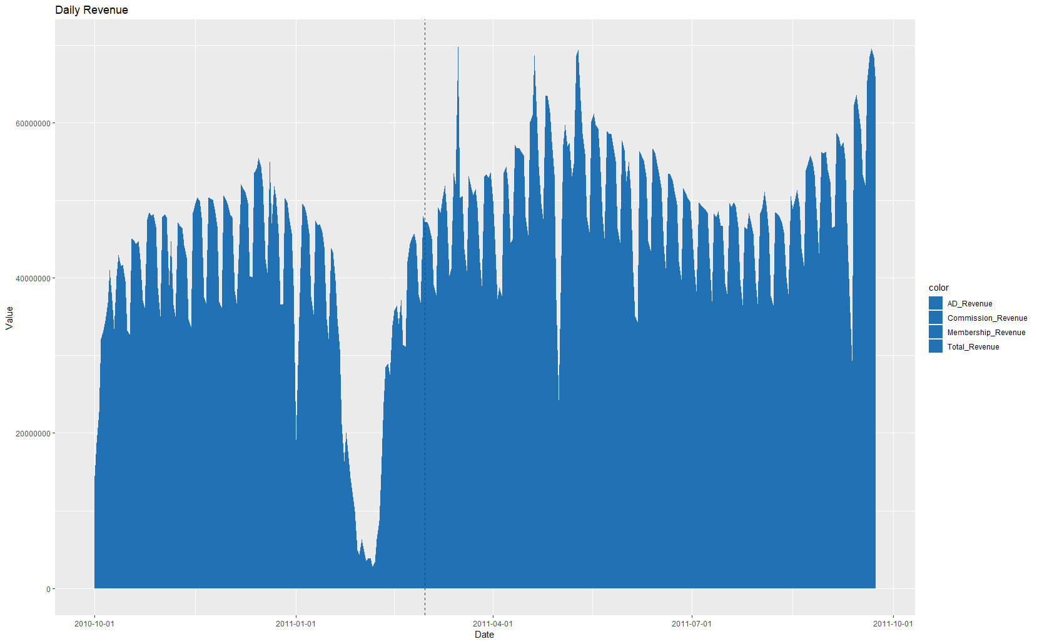
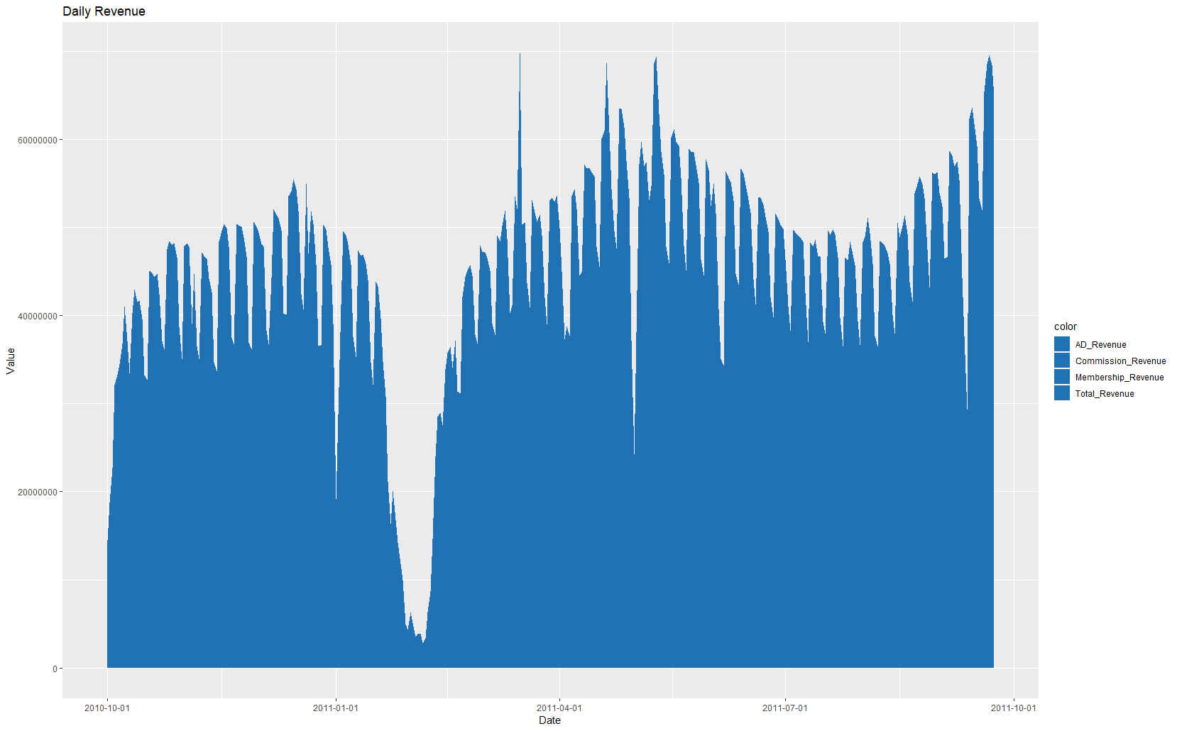
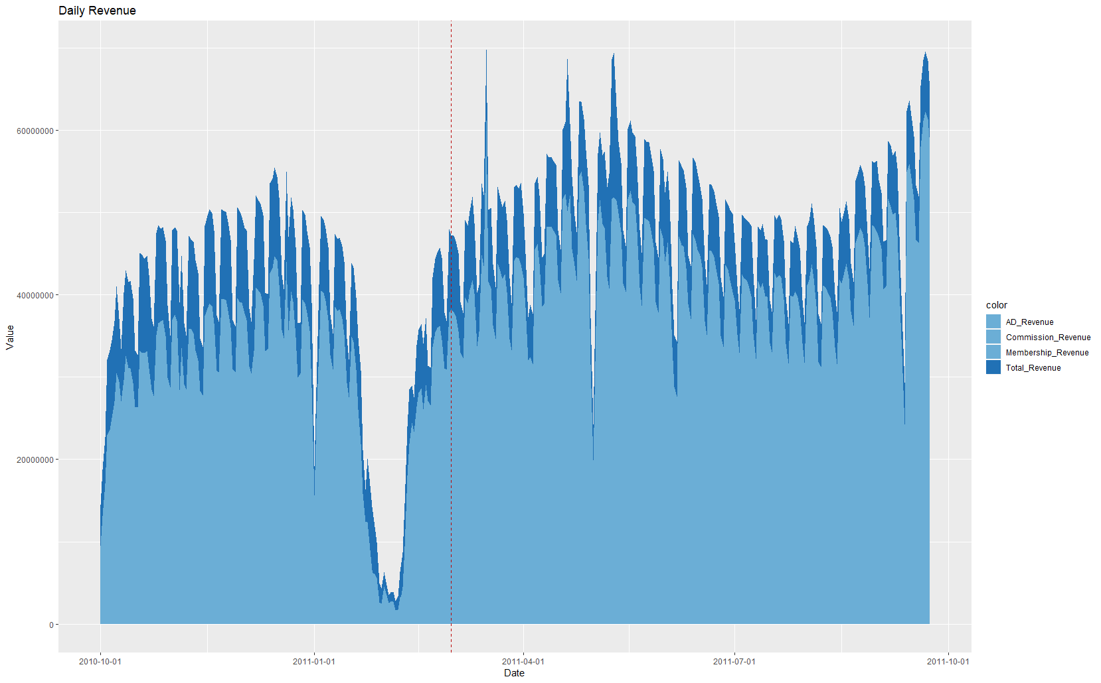
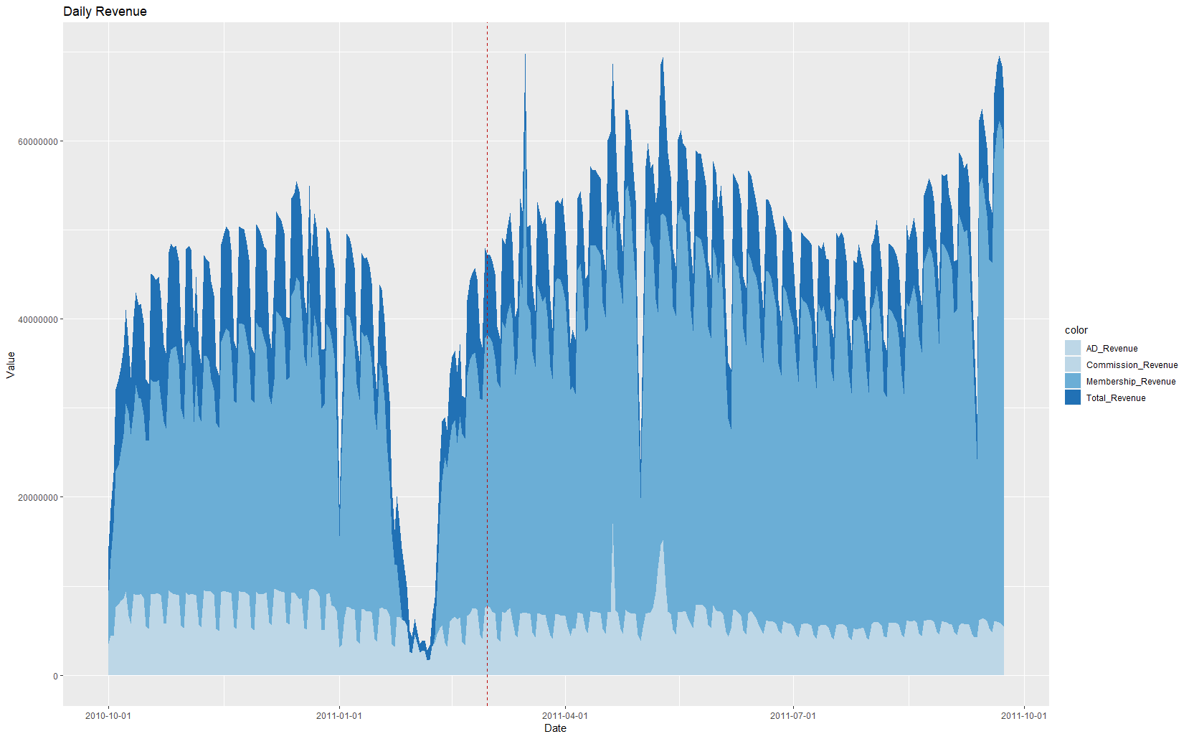

6/6 Dragon Boat
Festival
1/1 New Year
9/12 Mid-Autumn Festival
5/1 Labor Day
10/1
National Day
1/19~2/7 Chinese New Year

Slide 5
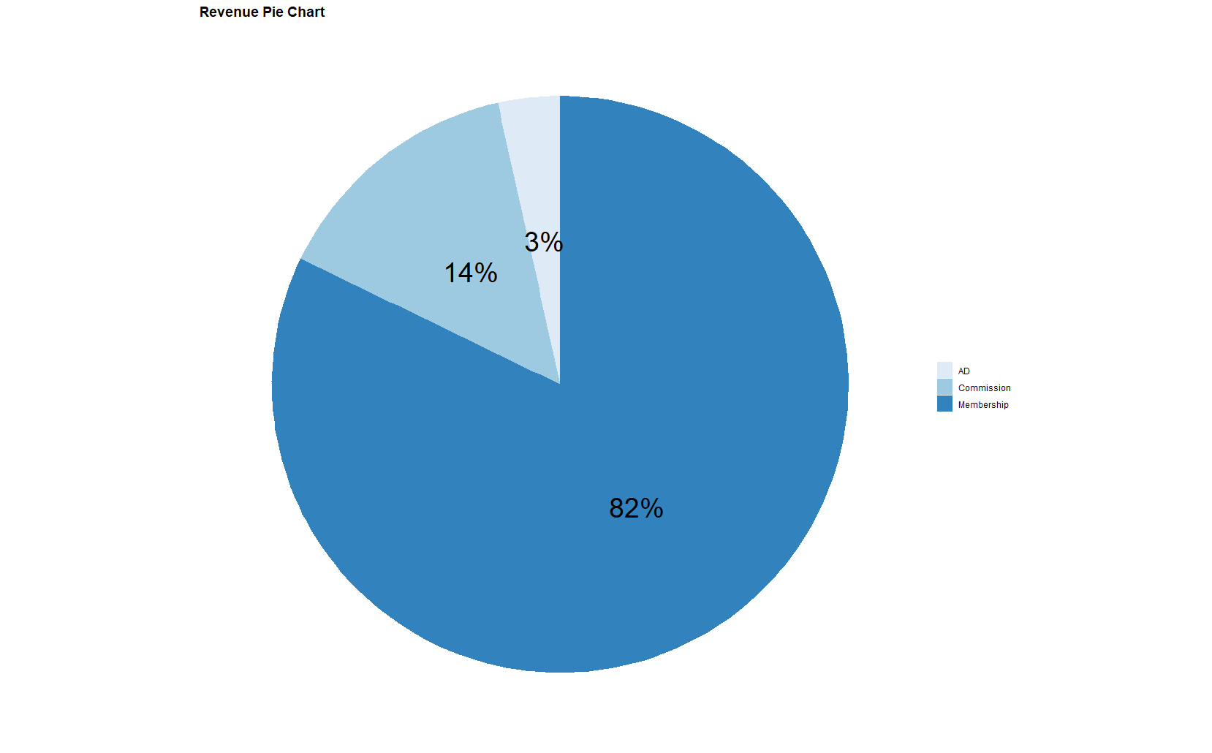
Introduction of Dataset
Revenue Pie Chart
Membership Revenue is 82.18% of Total Revenue
Commission Revenue is 14.34%
AD Revenue is 3.47%

Slide 6
Exploratory Data Analysis Direct, Search and Referral

Slide 7
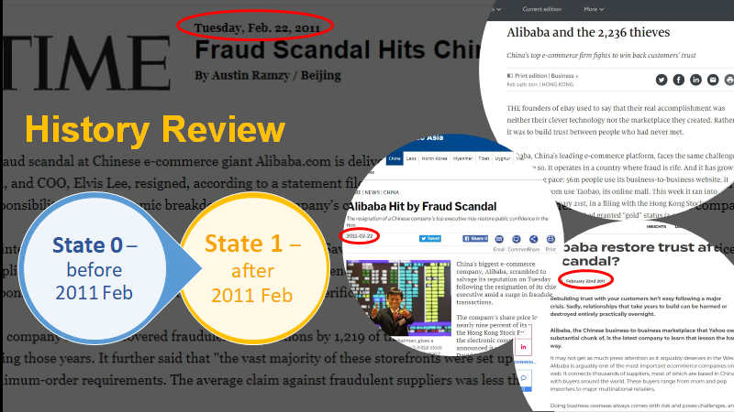

Slide 8
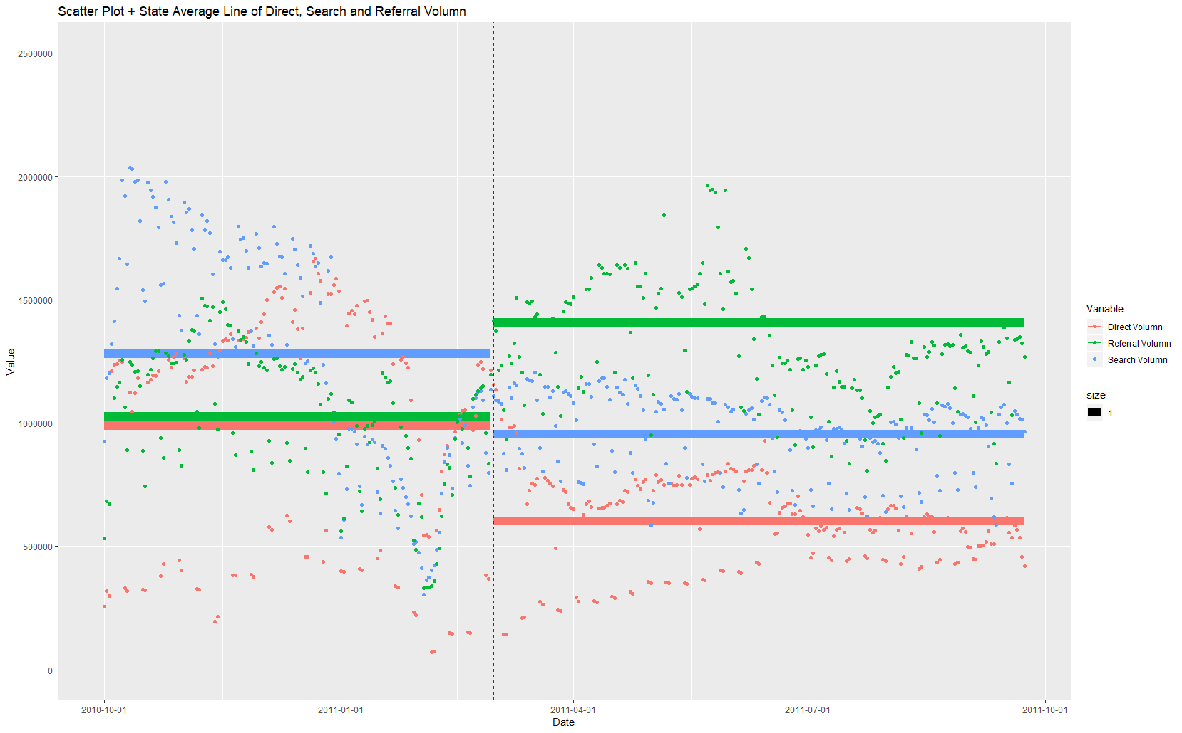


Slide 9
Exploratory Data Analysis
1
Search & Display AD
2
Seller Community
3
Membership
Notes:
Thanks, Chichi.
I will mainly analyze data related to search & display AD.
and then talk briefly about seller community and forum membership

Slide 10
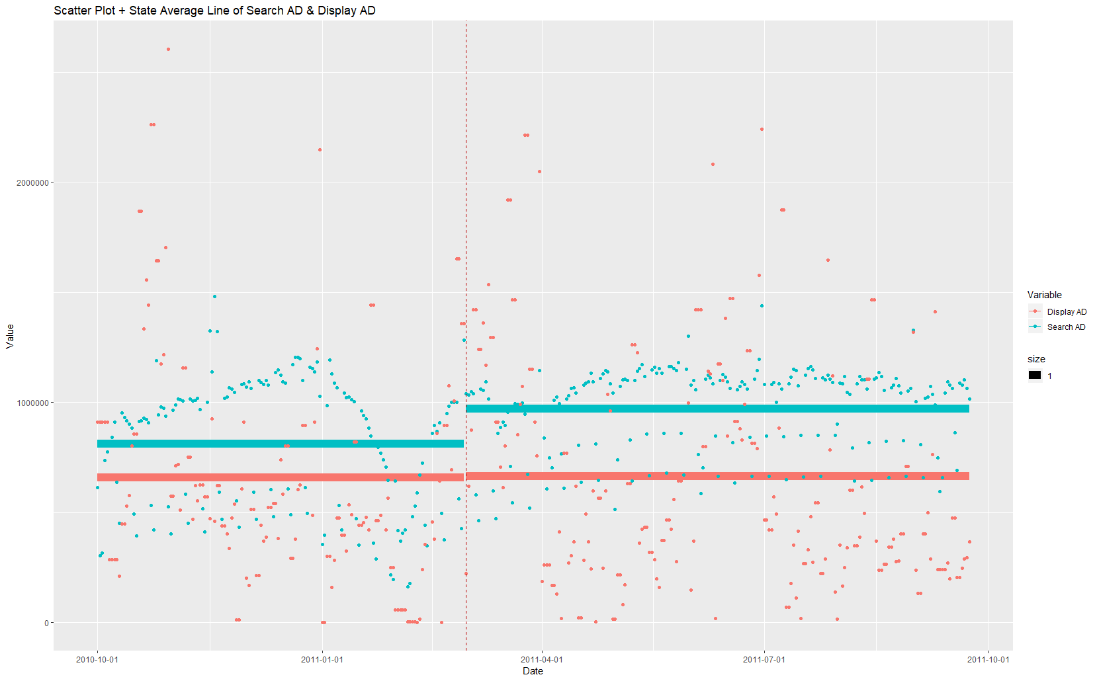
On average, revenue from
Search AD > Display AD
Notes:
Let’s see. This is scatter plot and state average line of search AD & Display AD. On average, revenue from search AD is always more than that from display AD. When state changes from 0 to 1, daily revenue that Alibaba made on search AD increased on average, the average revenue from Display AD remained unchanged.

Slide 11
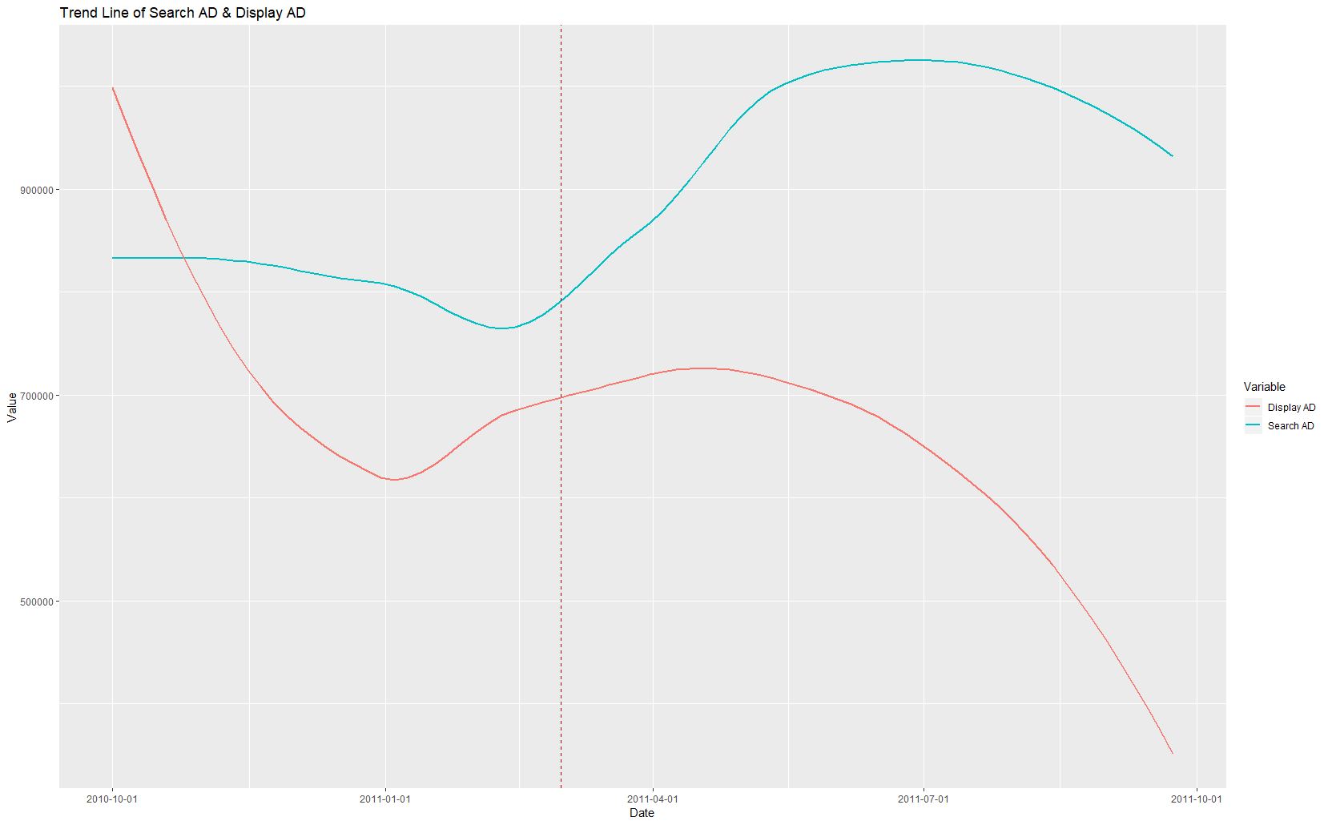
Overall, revenue that Alibaba makes on search AD per day was increasing,
but Display AD was decreasing
Notes:
The is trend line of search AD & display AD. During state 0, at first, revenue from display AD was higher than that from research AD, then search AD revenue excessed display AD revenue. Both were increasing slightly during the change of state. However, when it comes to state 1,overall, daily search AD revenue was increasing, but revenue from Display AD was decreasing sharply.

Slide 12
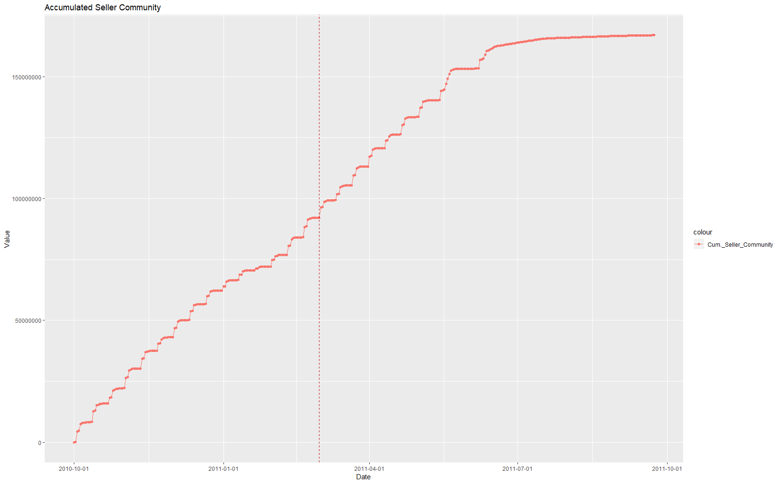
The growth rate of the number of people in Seller Community is gradually slowing down
Notes:
This graph shows accumulated number of people who joined in Seller Community. As shown in the graph, the growth rate of number of people in Seller Community is gradually slowing down.
(move back and forth to last slide and conclude) For the two facts that: 1.the decreasing daily revenue from display AD and 2. the slowing down growth rate of seller community. We can’t figure out why yet with current data, but we need more data with greater granularity, so that we can analyze further to find out the reasons

Slide 13
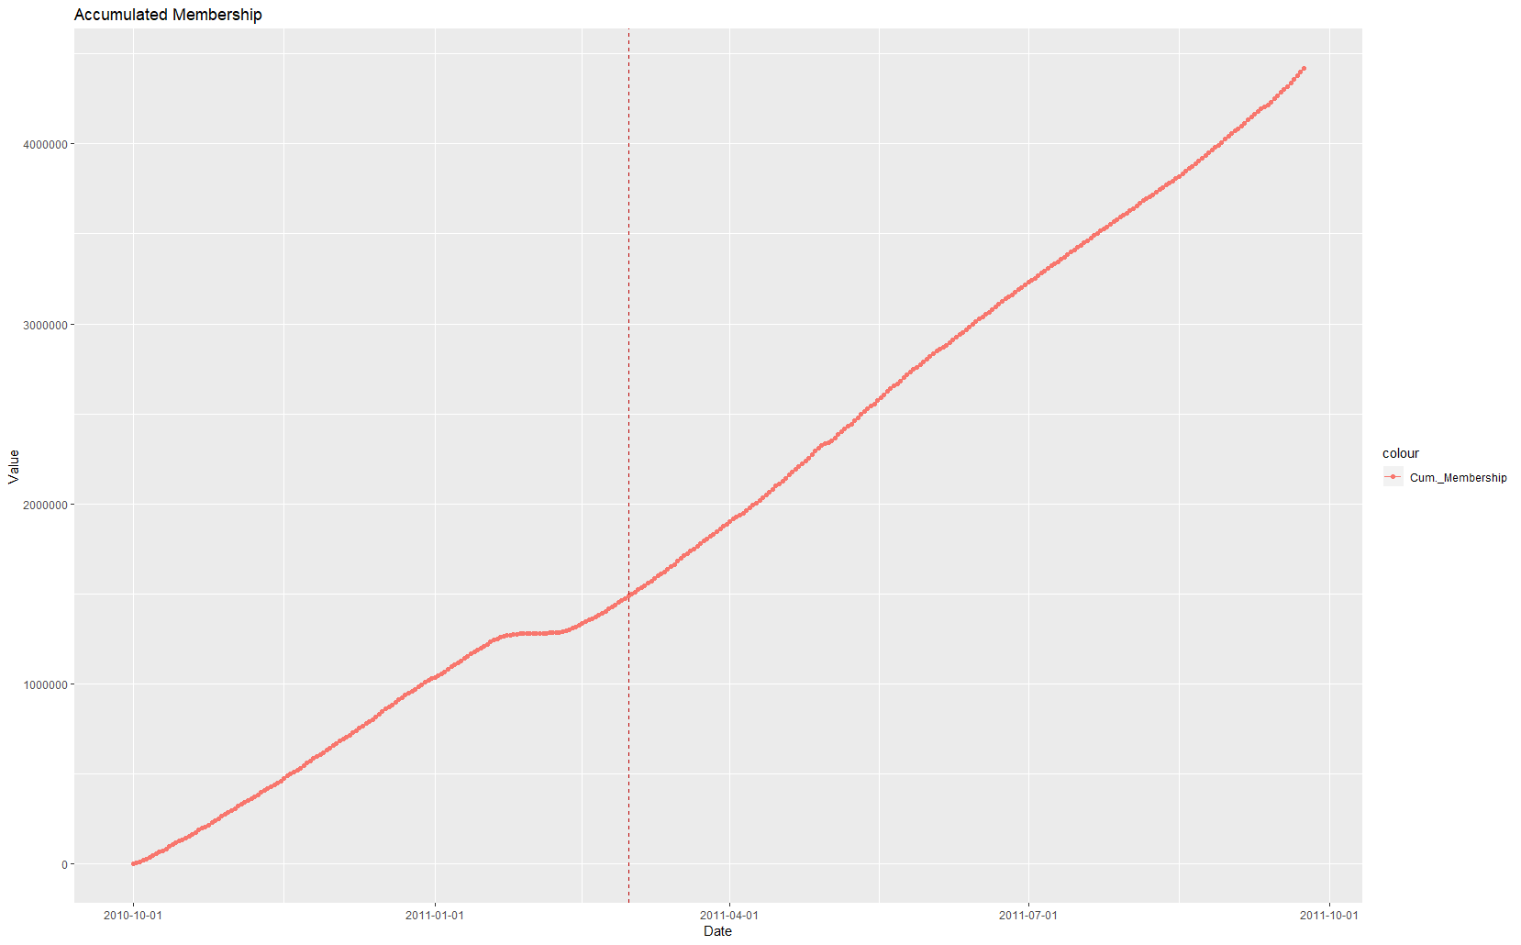
The growth rate of the forum membership is constantly increasing
Notes:
This graph shows accumulated membership. As you can see, the growth rate of the forum membership is constantly increasing and it seems like it was hardly affected by the state change. Therefore, in terms of subscription, we tend to keep it like before and focus on improving other two kinds of revenue resources. Now I will hand over to Chichi.

Slide 14
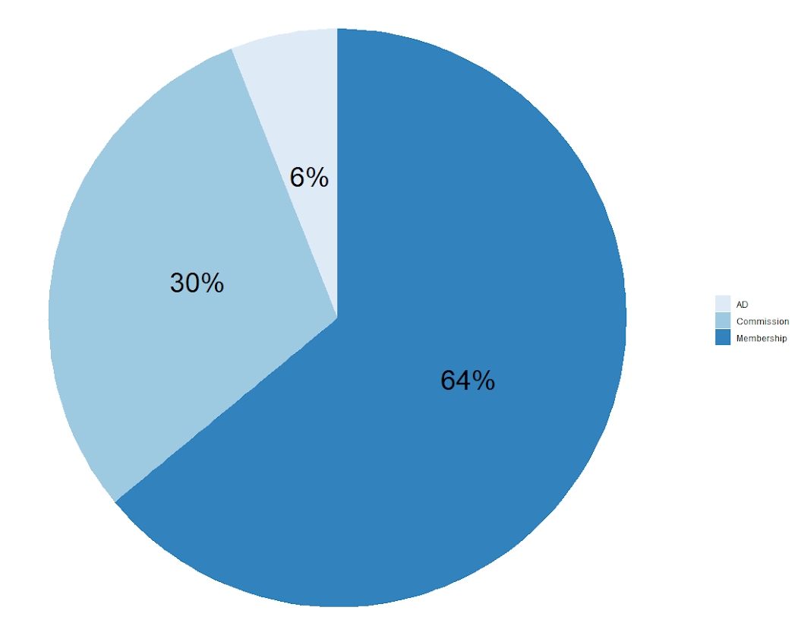
Business Strategy / Suggestion to increase revenue
Subscription Revenue is 82.18% → 64%
Commission Revenue is 14.34% → 30%
AD Revenue is 3.47% → 6%
Increase the revenue from Commission and other services

Slide 15
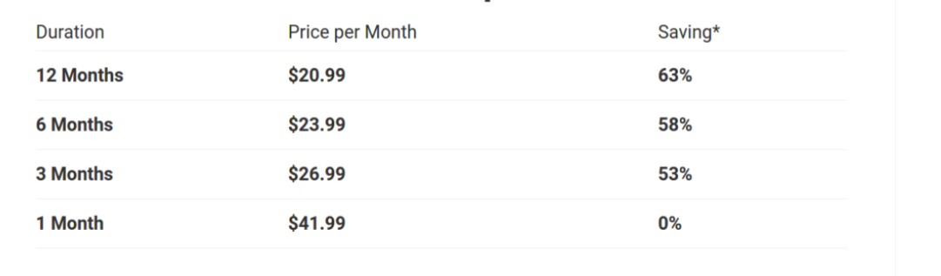
Recommendation: Subscription + Commission
With vast customer base and recurring revenue subcription works best
Basic and Premium package The basic package covers the general features required by the seller and premium will have enhanced features like customer behavior information and other privileges

Slide 16
Recommendation: Subscription + Commission
Commission differentiated for product categories basis demand- For example products like TV sets which are purchased one-time will have low commission than that of daily commodities items.
Commission is flexible on the price range of different products
Benefit
Alibaba gets a share of every transaction and each value that take place at their platform
Beneficial for the supplier as they have to pay the commission only after the sale of the product

Slide 17
Recommendation: Listing fee model
To take care of redundant data and increase revenue, listing fees can be used with a very low charge and enough flexibility on various products
With the constant lead flow, traffic and a vast customer, this model is lucrative
Benefit
Can control the product listing in the marketplace, ensure premium listing
Can charge for special products or categories
It will not be dependent on the sellers’ performance

Slide 18
Recommendation: Value added services
Providing loan to sellers - this provides loyalty to customers
Capitalize on buyer and supplier forum
Premium Ad Services
With additional fee, create dynamic contents with eye-catching graphic composition
It’s aimed to help boost click through impression (CTA) via appealing visual presentation

Slide 19
Thank You

